Slide 1

Course code: CSE3008
Course Title: Introduction to Machine Learning

Slide 2
Ensemble Learning
Suppose you are a movie director and you have created a short movie on a very important and interesting topic. Now, you want to take preliminary feedback (ratings) on the movie before making it public.
What are the possible ways by which you can do that?
1. You may ask one of your friends to rate the movie for you.
2. Another way could be by asking 5 colleagues of yours to rate the movie.
3. How about asking 50 people to rate the movie?
Diverse group of people are likely to make better decisions as compared to individuals. Similar is true for a diverse set of models in comparison to single models. This diversification in Machine Learning is achieved by a technique called Ensemble Learning.

Slide 3
Basic Ensemble Techniques (Max Voting, Averaging, Weighted average)
Max Voting: The max voting method is generally used for classification problems. In this technique, multiple models are used to make predictions for each data point. The predictions by each model are considered as a ‘vote’. The predictions which we get from the majority of the models are used as the final prediction.
Eg. when you asked 5 of your colleagues to rate your movie (out of 5); we’ll assume three of them rated it as 4 while two of them gave it a 5. Since the majority gave a rating of 4, the final rating will be taken as 4. You can consider this as taking the mode of all the predictions.

Slide 4
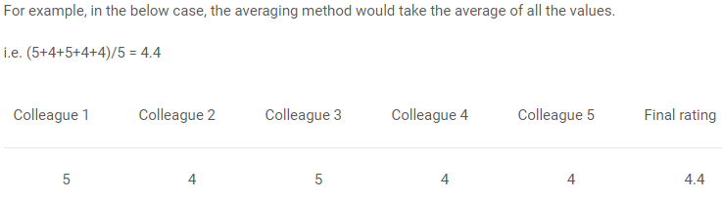
Basic Ensemble Techniques
Averaging: Multiple predictions are made for each data point in averaging. In this method, we take an average of predictions from all the models and use it to make the final prediction. Averaging can be used for making predictions in regression problems or while calculating probabilities for classification problems.
Eg. when you asked 5 of your colleagues to rate your movie (out of 5); we’ll assume three of them rated it as 4 while two of them gave it a 5. Since the majority gave a rating of 4, the final rating will be taken as 4. You can consider this as taking the mode of all the predictions.

Slide 5
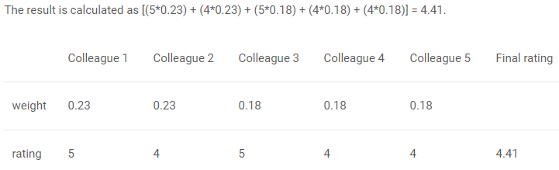
Basic Ensemble Techniques
Weighted Average: This is an extension of the averaging method. All models are assigned different weights defining the importance of each model for prediction. For instance, if two of your colleagues are critics, while others have no prior experience in this field, then the answers by these two friends are given more importance as compared to the other people.
Eg. when you asked 5 of your colleagues to rate your movie (out of 5); we’ll assume three of them rated it as 4 while two of them gave it a 5. Since the majority gave a rating of 4, the final rating will be taken as 4. You can consider this as taking the mode of all the predictions.

Slide 6
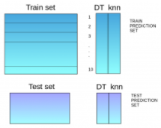
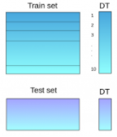
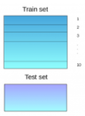
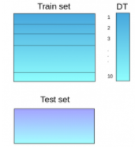
Advanced Ensemble Techniques (Stacking, Blending, Bagging, Boosting)
Stacking: It uses predictions from multiple to build a new model. This model is used for making predictions on the test set.
Step 1:
First Data is divided into train and test set and the train set is further divided into 10 smaller parts.
Step 2:
A base model say: DT is fitted on 9 parts and predictions are made on 10th part. The same process is repeated for each part of train set.
Step 3:
Using this model fitted on the whole training set, predictions are made on the test data.
Step 4:
Steps 2 & 3 are repeated for another base model: Say KNN

Slide 7
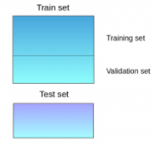
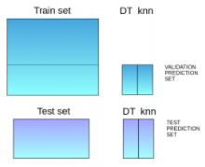
Advanced Ensemble Techniques
Blending: follows the same approach as stacking but uses only a holdout (validation) set from the train set to make predictions. In other words, unlike stacking, the predictions are made on the holdout set only. The holdout set and the predictions are used to build a model which is run on the test set.
Step 1:
First Data is divided into train and test set.
Step 2:
The train set is split into training and validation sets.
Step 3:
Base models are fitted on the training set and predictions are made on the validation set and test set.
Step 4:
The validation set and its predictions are used as features to build a new model and this model is used to make final predictions on the test features.

Slide 8
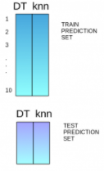
Advanced Ensemble Techniques
Step 5:
The predictions from the train set are used as features to build a new model.
Step 6:
This model is used to make final predictions on the test prediction set.

Slide 9
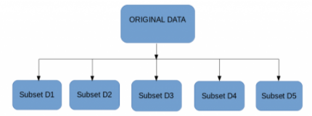

Advanced Ensemble Techniques
Bagging: The idea behind bagging is combining the results of multiple models (for instance, all decision trees) to get a generalized result.
If we create all the models on the same set of data and combine it, will it be useful? There is a high chance that these models will give the same result since they are getting the same input. So how can we solve this problem? One of the techniques is bootstrapping.
In Bootstrapping, some subsets of observations are created from the original dataset, with replacement. Bagging /Bootstrap Aggregating uses these subsets (bags) to get a fair idea of the distribution (complete set). The size of subsets created for bagging may be less than the original set.

Slide 10
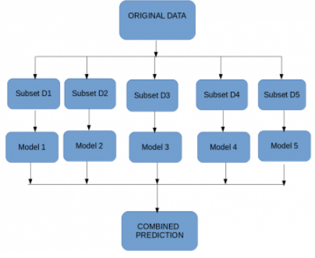
Advanced Ensemble Techniques
A base model (weak model) is created on each of these subsets.
The models run in parallel and are independent of each other.
The final predictions are determined by combining the predictions from all the models.

Slide 11
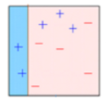
Advanced Ensemble Techniques
If a data point is incorrectly predicted by the first model, and then the next (probably all models), will combining the predictions provide better results? Such situations are taken care of by boosting.
Boosting: Boosting is a sequential process, where each subsequent model attempts to correct the errors of the previous model. The succeeding models are dependent on the previous model.
1: A subset is created from the original dataset.
2: Initially, all data points are given equal weights.
3. A base model is created on this subset.
4. This model is used to make predictions on the whole dataset.

Slide 12
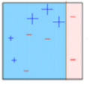
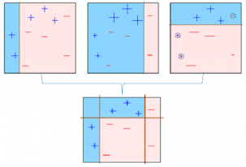
Advanced Ensemble Techniques
5. Errors are calculated using the actual values and predicted values.
6. The observations which are incorrectly predicted, are given higher weights. (Here, the three misclassified blue-plus points will be given higher weights)
7. Another model is created and predictions are made on the dataset. (This model tries to correct the errors from the previous model)
8. Similarly, multiple models are created, each correcting the errors of the previous model.
9. The final model (strong learner) is the weighted mean of all the models (weak learners)
Thus, the boosting algorithm combines a number of weak learners to form a strong learner. The individual models would not perform well on the entire dataset, but they work well for some part of the dataset. Thus, each model actually boosts the performance of the ensemble.

Slide 13
Algorithms based on Bagging Boosting
Bagging and Boosting are two of the most commonly used techniques in machine learning.
Bagging algorithms:
Bagging meta-estimator
Random forest
Boosting algorithms:
AdaBoost
GBM
XGBM
Light GBM
CatBoost

Slide 14
RANDOM FORESTS

Slide 15
DEFINITION
Random Forests are an ensemble learning method for classification & regression
Ensemble methods are made up of multiple learning algorithms, which collectively provide better prediction as compared to any single one of them.
They are made up of multiple decision trees
The output is
the mode of the predicted classes ( in case of classification), and
the mean of the prediction value ( in case of regression) provided by the individual trees.

Slide 16
ORIGIN OF RANDOM FORESTS
Algorithm developed by Leo Breiman and Adele Cutler.
Leo Breiman
January 27, 1928 – July 5, 2005
Professor Emeritus of Statistics at University of California, Berkeley.
Adele Cutler is his long-time collaborator and former Ph.D student.
“Random Forests” is their trademark.

Slide 17
ORIGIN OF RANDOM FORESTS
Bagging (also known as ‘bootstrap aggregation’)
From your full dataset, take a sample , generate a tree and obtain predictions.
Repeat with a different sample, from the same dataset. The new tree will typically make different predictions.
Continue sampling and generating trees in this manner till about ‘n’ trees are obtained.
This process is called “Bagging”.

Slide 18
ORIGIN OF RANDOM FORESTS
‘Out of Bag’ (OOB) Data
If we sample from available data and build a tree, we already have holdout data available for that tree. This data is referred to as “Out of Bag” data.
Every tree grown has a different holdout sample
Every record in the full dataset is “in bag” for some trees(about 2/3rd) and “out of bag” for the other trees.

Slide 19
ORIGIN OF RANDOM FORESTS
‘Out of Bag’ (OOB) Data
Suppose a given record was “in bag” for 375 trees and “out of bag” for the remaining 125 trees(total of 500 trees)
Predictions for this record could be generated using just the “out of bag” trees.
Always having OOB data means we can effectively work with relatively small datasets.

Slide 20
TYPES OF SAMPLING
Simple random sampling
There is an equal probability of selecting any particular item
Sampling without replacement
Once an object is selected, it is removed from the population
Sampling with replacement
A selected object is not removed from the population
Stratified sampling:
Partition the data set, and draw samples from each partition (proportionally, i.e., approximately the same percentage of the data)

Slide 21
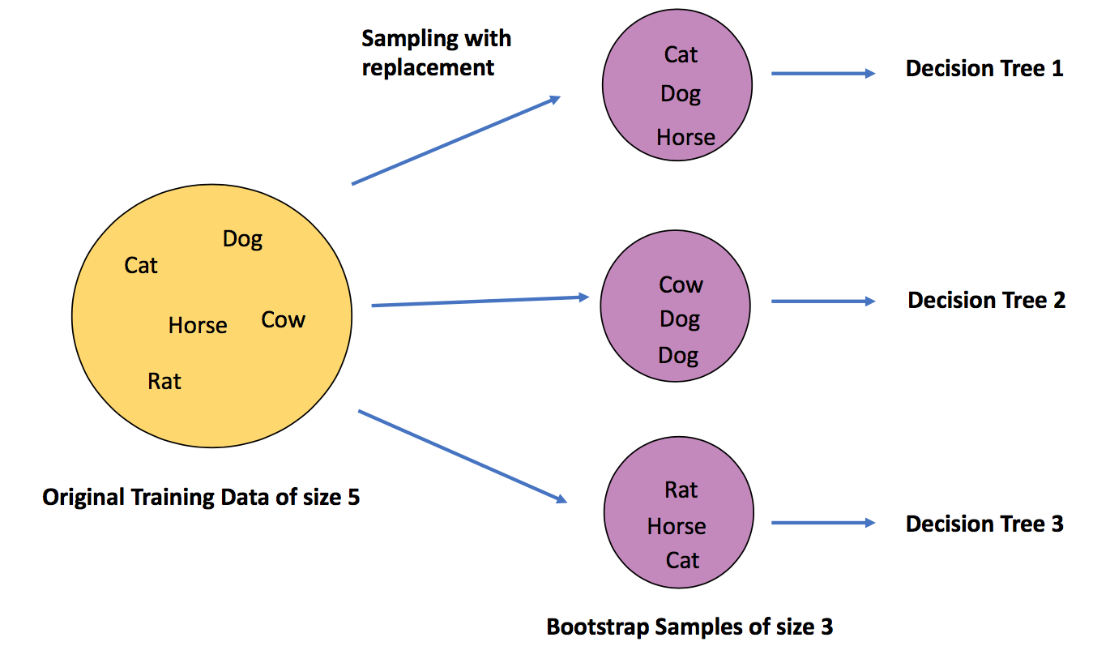
‘Out of Bag’ (OOB) Data example

Slide 22
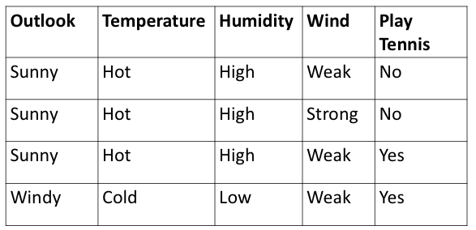
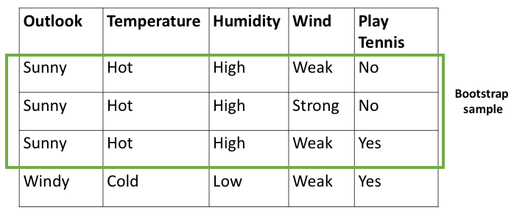
‘Out of Bag’ (OOB) Data example

Slide 23
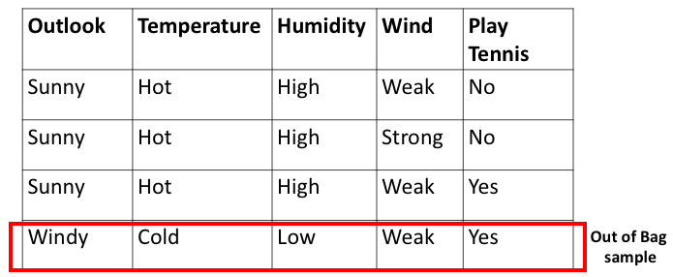
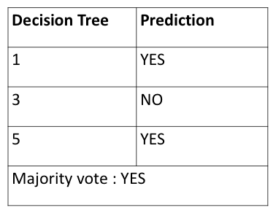
‘Out of Bag’ (OOB) Data example

Slide 24
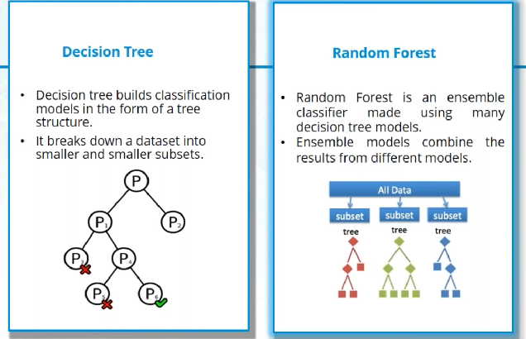
Random Forest

Slide 25
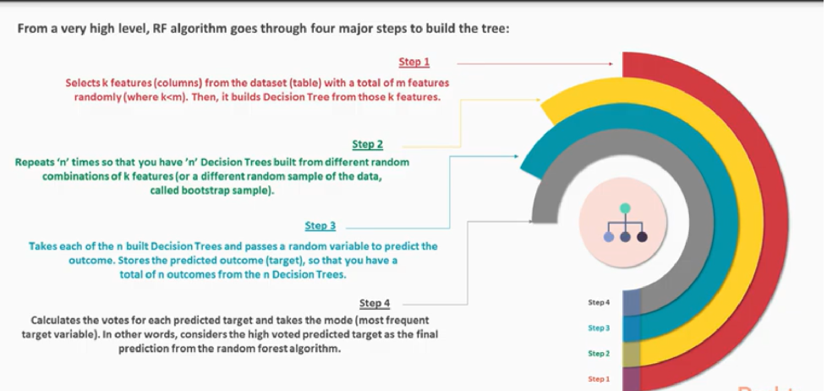
Random Forest Algorithm

Slide 26
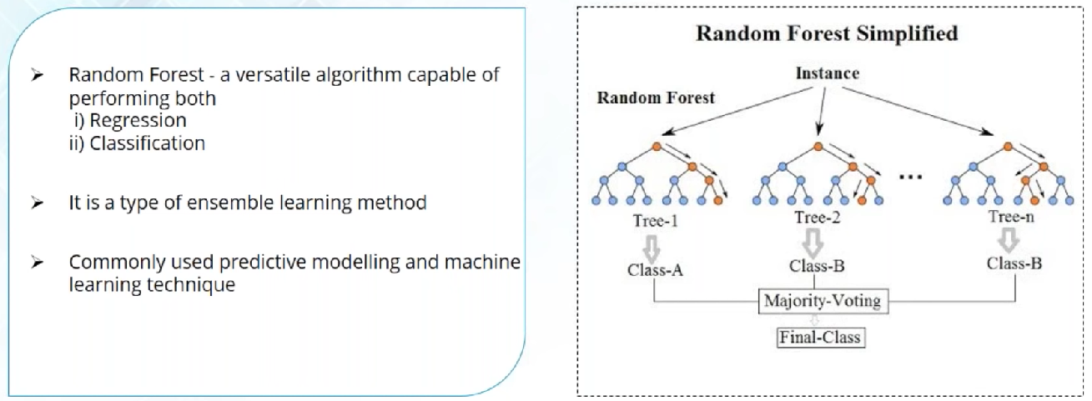
Random Forest

Slide 27
ADVANTAGES OF RANDOM FORESTS
Automatic identification of important predictors
Good for wide data; provide good accuracy and generate reliable predictor importance rankings.
Resistant to over training.
Each decision tree is independent. Therefore trees can be grown on different cores or different computers, allowing for quicker analysis.

Slide 28
SHORTCOMINGS OF RANDOM FORESTS
Suited for wide datasets with only a moderate number of rows. Breiman recommends the use of other tools for larger datasets.
Large memory needed to store built models.
Overfitting might be seen with noisy data.

Slide 29
APPLICATIONS OF RANDOM FORESTS
Online targeted marketing
Credit card fraud detection
Text analytics
Credit risk and insurance risk
Retail Sales prediction
Biological & Medical Research
Manufacturing Quality Control

